Slide 1
Student management

Slide 2
Student management
A Student Management system is an application is designed to use
maintain student records .
It helps to reduce paper works and makes the job more easy and efficient
It automates every thing on its own no need for human intervention
It is user friendly

Slide 3
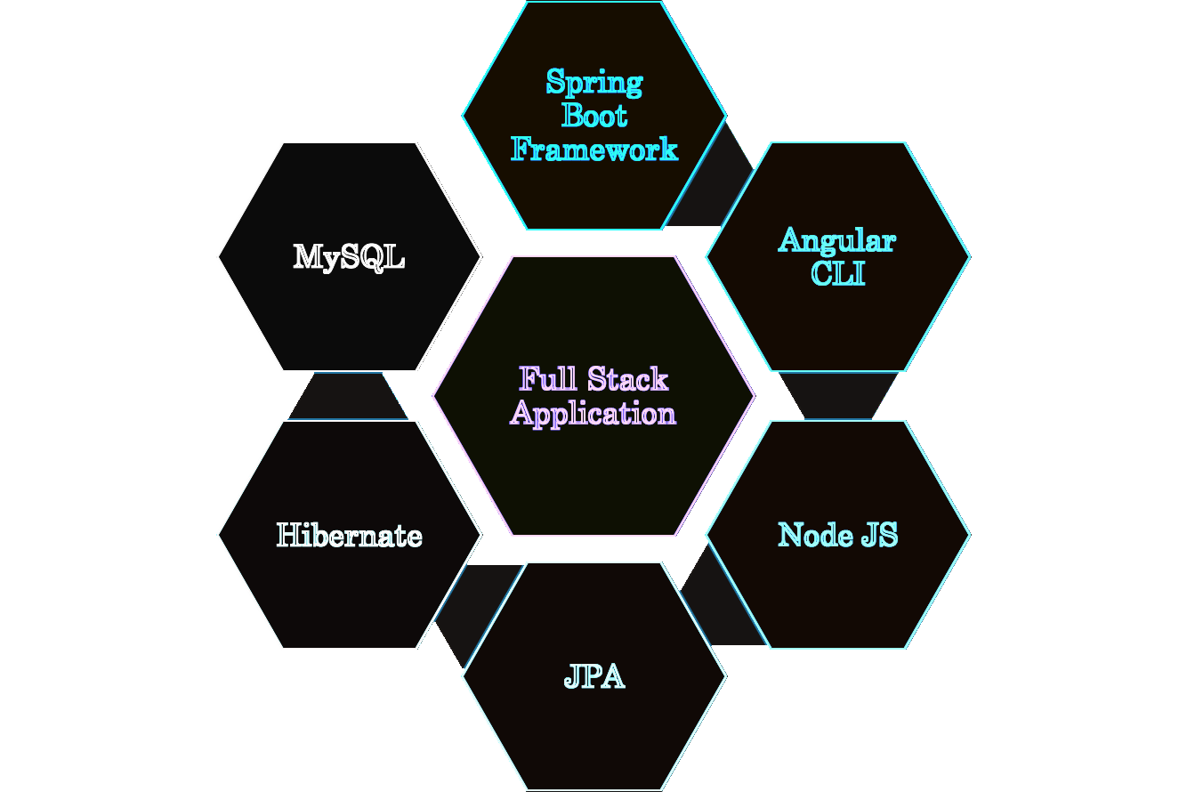
Technologies used

Slide 4
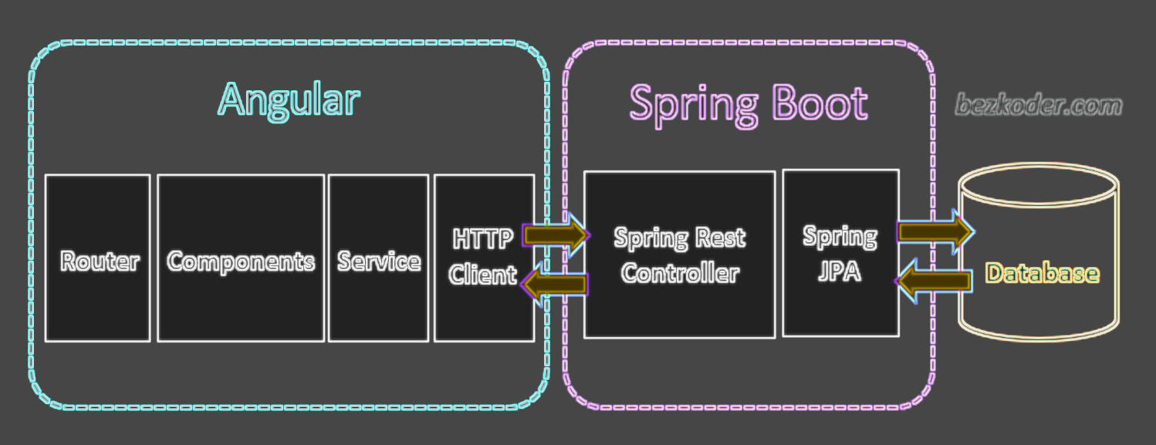
The Architecture of Angular, Spring & database(MySQL)

Slide 5
Git-hub link
https://github.com/saravana2000/Student.git

